Slide 2
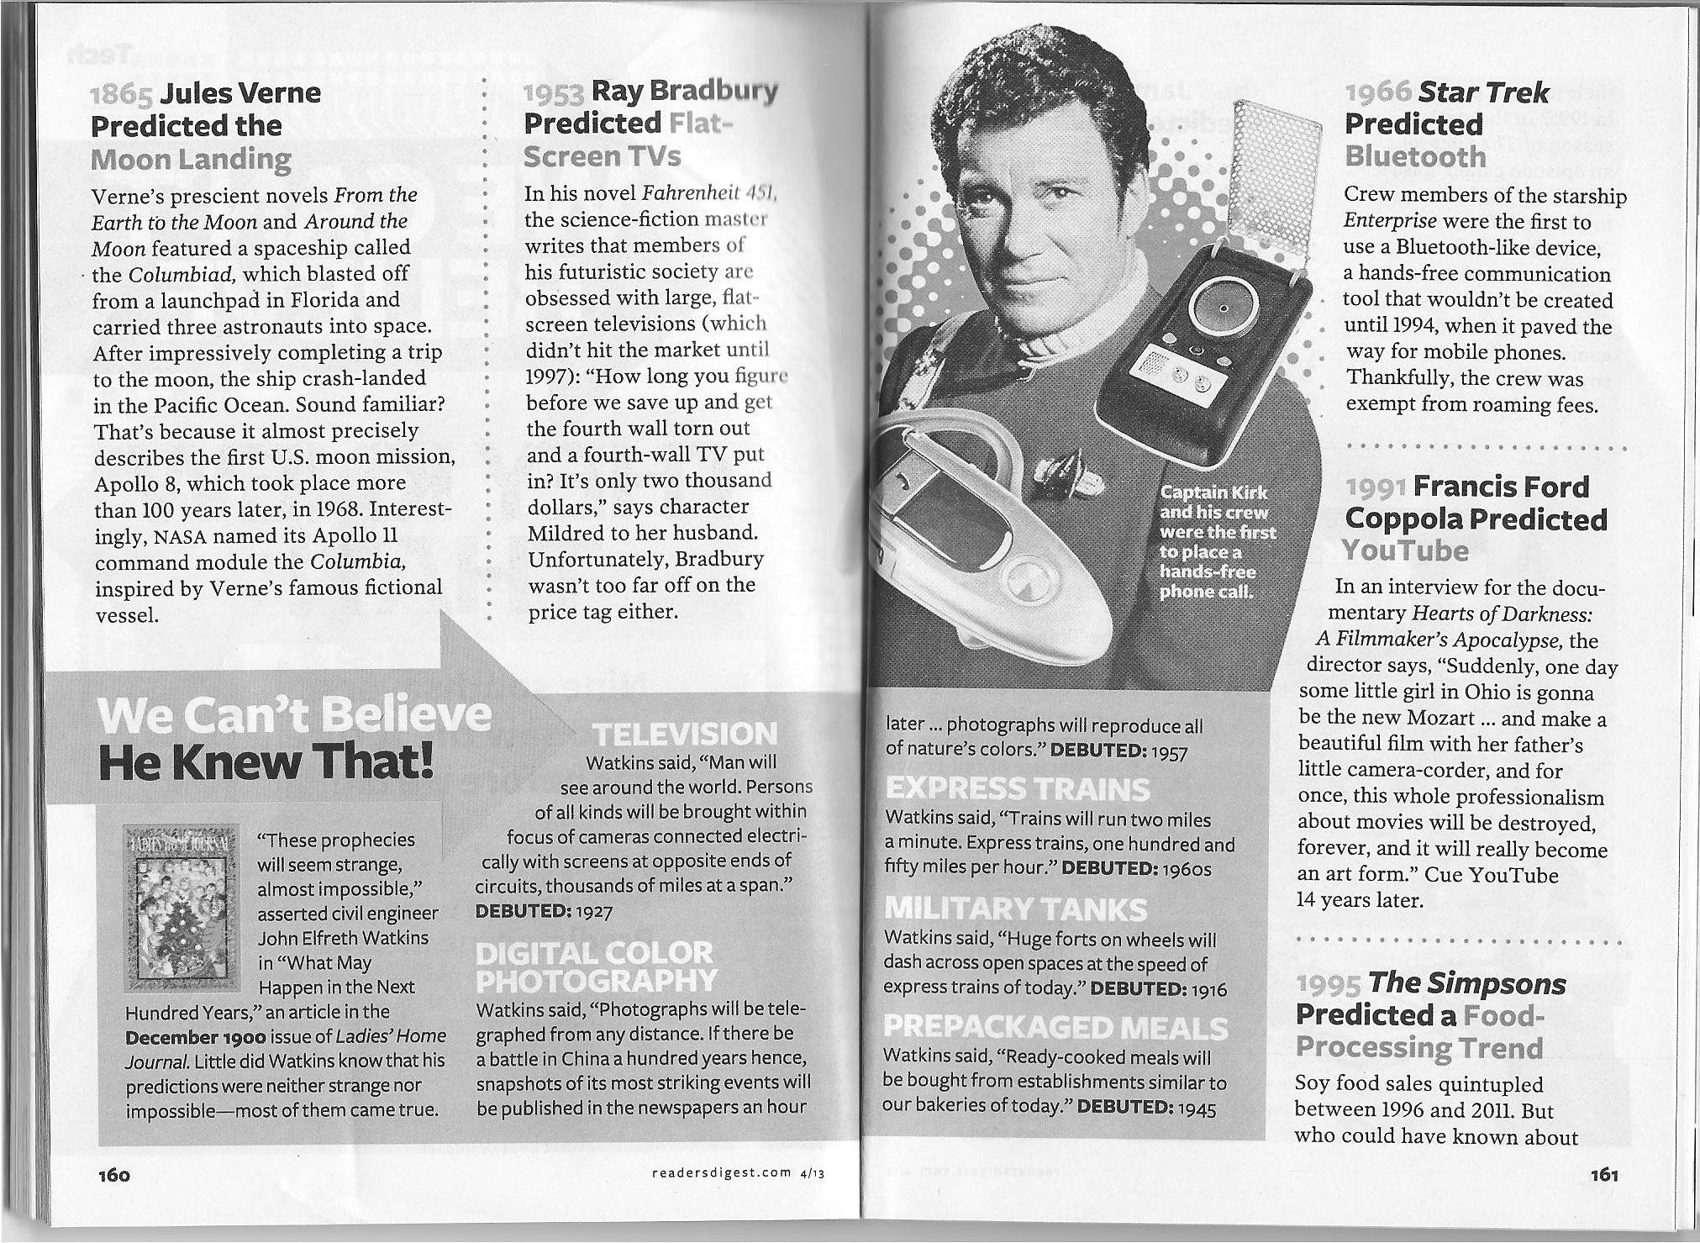

Slide 3
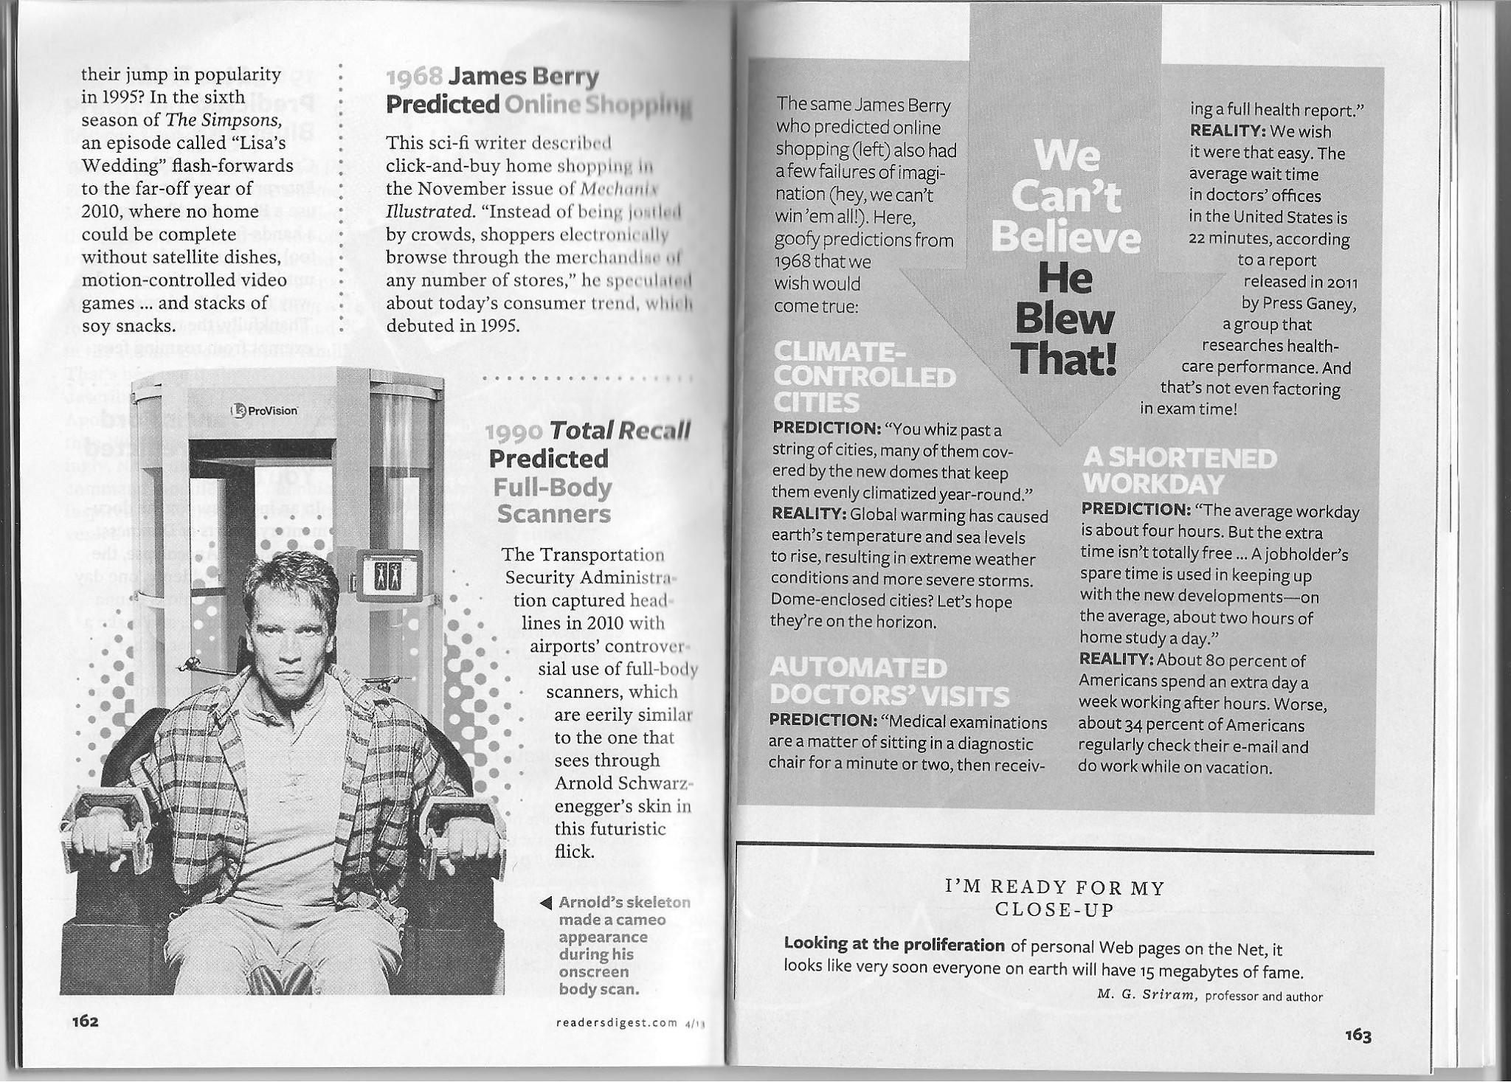

Slide 4
~PREDICT THE FUTURE~ ACTIVITY
On a sheet of paper folded in half (like a book)
Make two predictions for something that you think will be invented within the next 50-100 years!
Describe, in at least three sentences, what you think will be invented, then provide an image to depict this prediction.

