Slide 1
Introduction to Chinua Achebe and Things Fall Apart

Slide 2
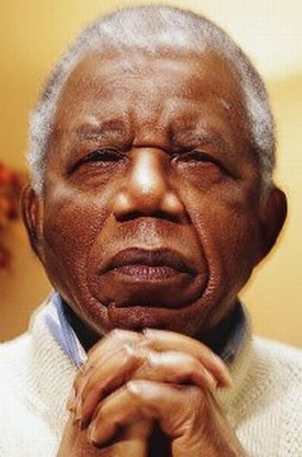
Who is Chinua Achebe?
Born Albert Chinualumogu Achebe in 1930 in Nigeria; died 2013
Born to Ibo parents who were deeply Protestant; he was raised in the Protestant denomination
Highly educated, often wrote about traditional African culture
Called the “father of African literature”

Slide 3
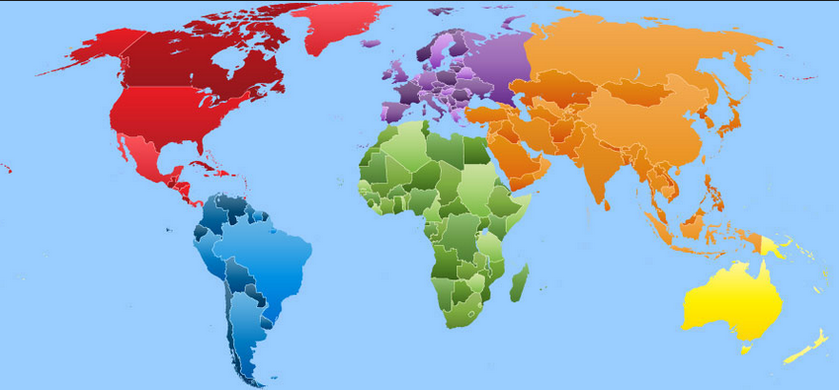
FIND AFRICA…

Slide 4
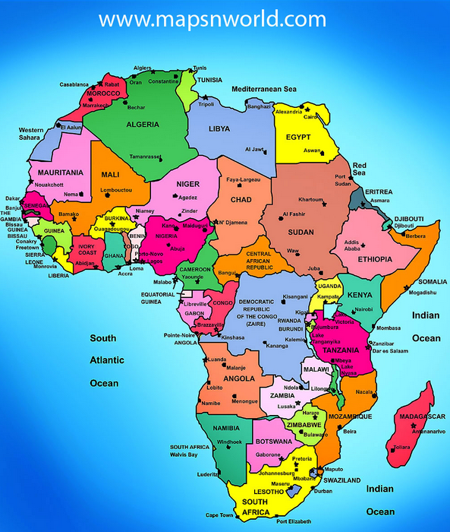

Slide 5
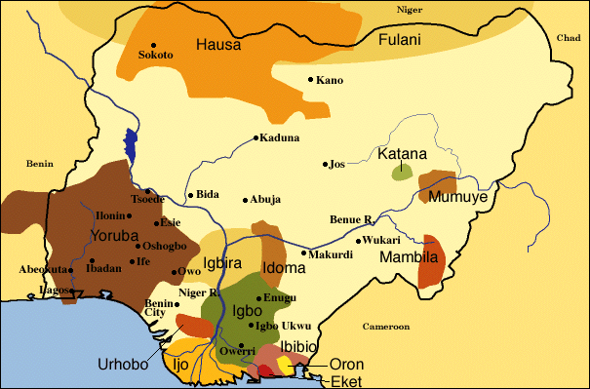

Slide 6
What was important to Achebe?
He wrote satirical and serious literature about the weakening African culture under European (British) colonization
He critiqued the corrupt Nigerian and British governments that controlled the Ibo people
He criticized the unstable Nigerian government.
Oral tradition, such as folk tales and songs, and verbal descriptions of life and life lessons—Achebe tried to keep alive important aspects of the Ibo culture in his writing
Family and relationships in the light of African colonization were a large part of Achebe’s literature
Politics and African colonization
African Culture, Family, and Tradition

Slide 7
What did Achebe write about?
African Colonialism and Culture
Achebe looked at the African experience under white Christian colonialism as a “systematic emasculation of the entire African culture” (Nigerian professor Ernest N. Emenyonu).
Urban development threatening African traditions.
Important note: He tries not to take a side; he remains as neutral as possible in his writing.

Slide 8
About what did Achebe write?
Masculinity and Femininity
Many of his main characters portray a traditional, patriarchal Ibo (Igbo) society. (Ibo are the people of southeastern Nigeria.)
Men take numerous wives
Women are beaten regularly
It has been argued that the presence of such masculinity is simply a description of the society from which he comes and can be seen as an indictment of those gender roles.
Some of his female characters represent balance and go against the regular male character that shuns femininity as a bad thing.

Slide 9
Nigeria
Most populous country in Africa (approx. 196.9 million)
Twice the size of California
Large oil supplier to the U.S.
Under British rule from 1900 until 1960, when independence was finally achieved
From 1966-1999, Nigeria was ruled by a series of military dictators

Slide 10
Nigeria
Democracy was finally established in 1999.
This history of violence & oppression in Africa affected Achebe and telling this story became one of his purposes in writing Things Fall Apart.

Slide 11
Things Fall Apart
Set in the late 1800s-early 1900s or sometime during the British conquest of Nigeria, which lasted from 1890-1906
Published in 1958 while Nigeria was still under colonial rule
About the clash between the traditional Ibo (native) culture and the missionaries and colonizers of Britain

Slide 12
Things Fall Apart
Tells the story of Okonkwo, an overly masculine leader and wrestling champion in the fictional Nigerian village of Umuofia.
Focuses on Okonkwo, his wives and children, the Igbo (Ibo) community in which he lives, and the white missionaries who attempt to introduce Christianity to the Igbo culture.
Uses superstition and folklore to tell Okonkwo’s sad story; his life takes a wrong turn after he participates in a terrible crime in order to avoid looking effeminate.

Slide 13
Themes in Things Fall Apart
Different cultures are not necessarily unequal; this superior/inferior belief will lead to eventual tension and destruction of both cultures.
Cultures are dynamic; they must be flexible and evolve with changing outside forces.
Masculinity and femininity should not be viewed in very strict terms. Such cut and dry perspective does not allow a person to adapt to their surroundings.
Success and failure are self-determined. We as human beings define them, in our own individual terms, as suited to our needs, values, and cultural experiences.

Slide 14
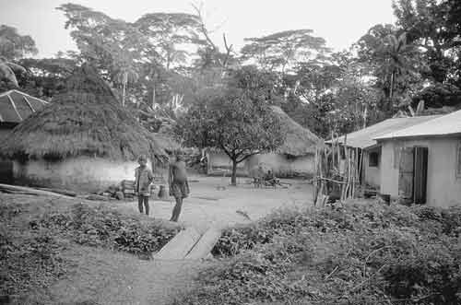
IBO VILLAGE SCENE

Slide 15
A MUD HOUSE

Slide 16
A NIGERIAN FARM LIKE OKONKWO’S

Slide 17
IBO WARRIORS

Slide 18
IBO WRESTLERS

Slide 19
IBO DANCERS

Slide 20
IBO MEN AND BOYS

Slide 21
NIGERIAN DANCE MASK

Slide 22
A CHRISTIAN CHURCH

Slide 23
SOURCES FOR PICTURES
http://lindseyfidler.blogspot.com/2007_06_01_archive.html
http://www.everyculture.com
http://www.unc.edu/~hhalpin/ThingsFallApart/links.html
http://www.stfrancis.edu/content/en/student/achebe/chinua/igbo.htm

